Slide 1

BusyBee
Connect with your kids and make parenting a breeze with BusyBee

Slide 2


Team Poize
Category – Open Innovation

Slide 3
Agenda
1
2
3
4
5
Introduction
Primary Goals
Areas of Growth
Timeline
Summary

Slide 4
Problem
According to NASDAQ around 70% of families lose their generational wealth by the 2nd and 90% by the 3rd , which is majorly due to lack of financial management knowledge.
Majority of parents in India consider money not an important topic to discuss as they think it promotes entitlement in children Many refuse to let children have access to disposable income like pocket money as they think it would be wasted.
This lead children late in life having no financial knowledge or discipline to spend money wisely and This leads to wild spending and the outflow of cash increases more than the influx, which leads to decline in wealth.
Due to rise in Living costs dual income households are on a rise where both parents work to earn a living leaving the kid either alone or with a caretaker(grandparents or babysitters)

Slide 5
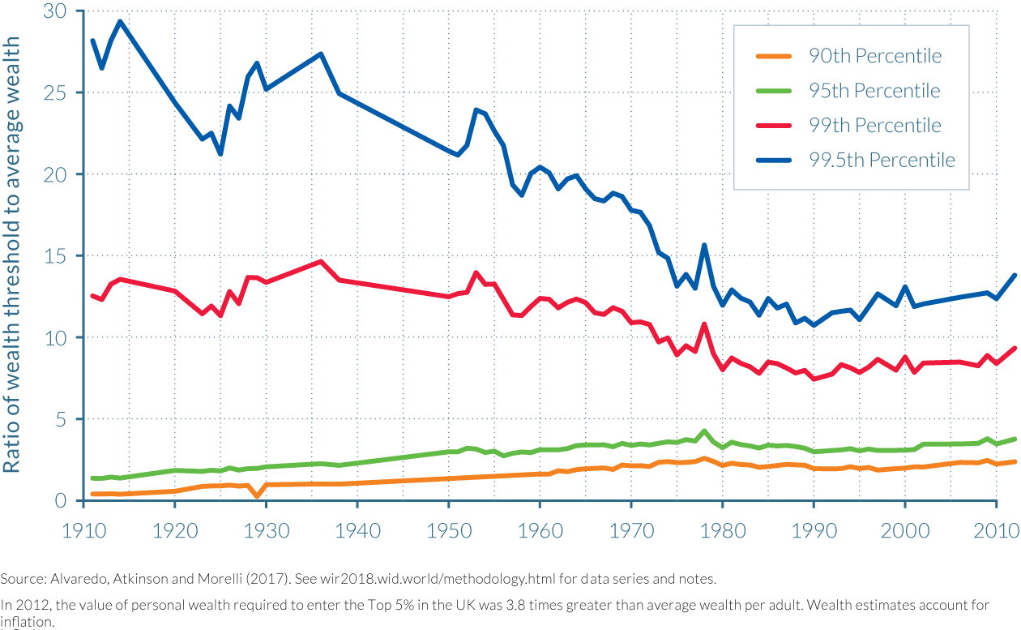
Wealth Problems

Slide 6

Role of Busy Bee
Annual Revenue Growth

Slide 7
The more you learn The more you earn
“
”

Slide 8
Our Solution
BusyBee works by rewarding children with honey(virtual currency) which can be used to redeem reward determined by the parents
We created BusyBee as solution to help inculcate discipline and good habits in children by the use of positive reinforcement.
Parents can provide task for the children to complete which rewards them with honey after being verified by the parent.
The child can then use the honey earn by him to redeem rewards preset by the parent.

Slide 9
Working
Parent Side App
Child Side App

Slide 10

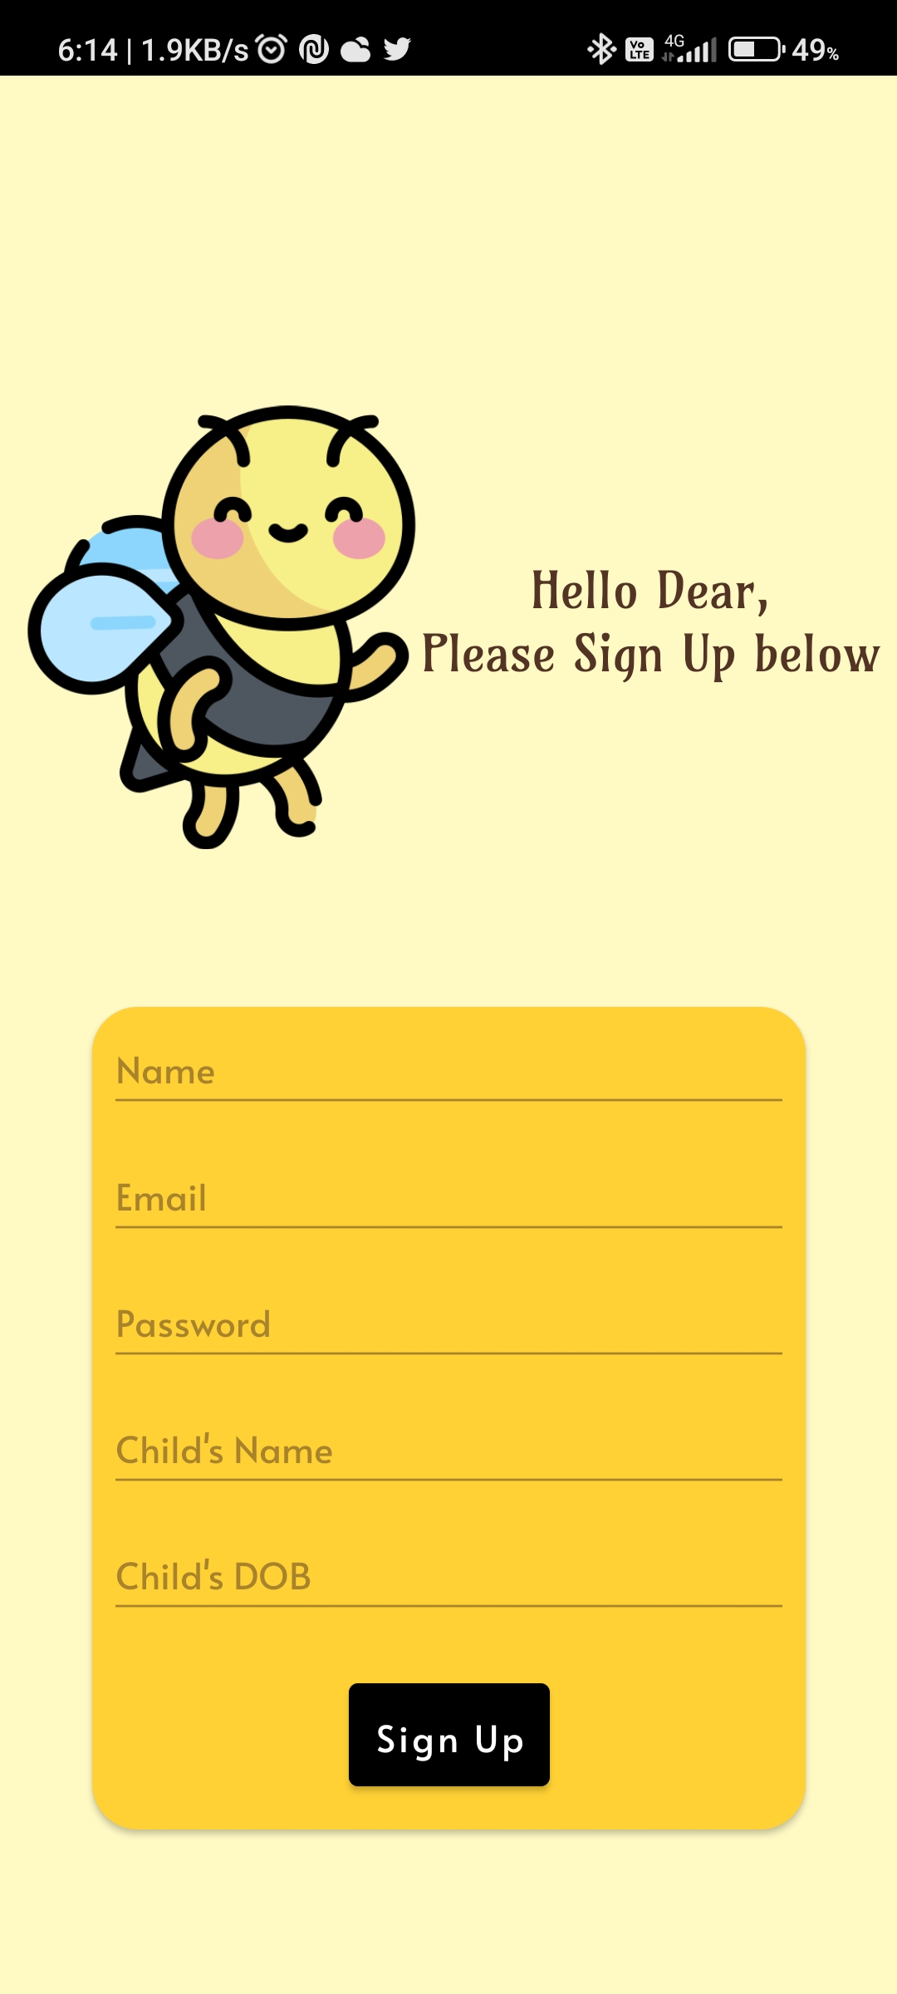
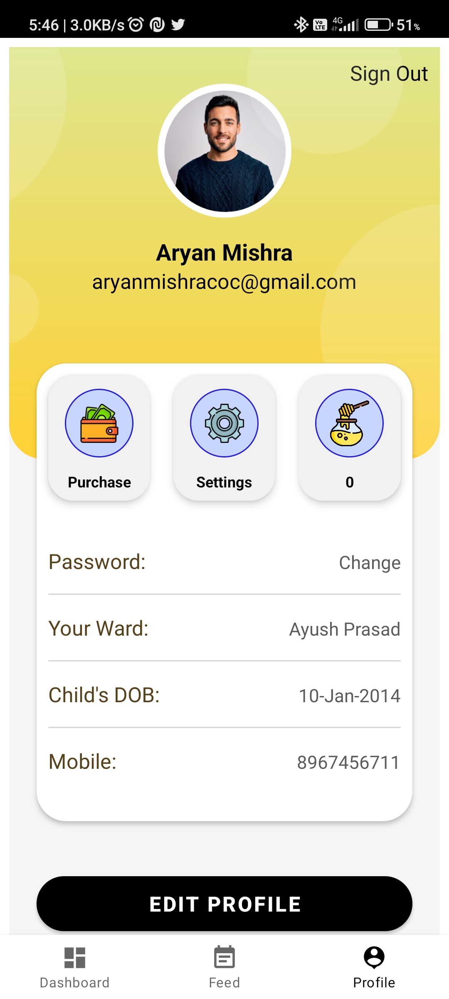
Parent Side App
Create an Account or Login
Enter account details
See your profile

Slide 11
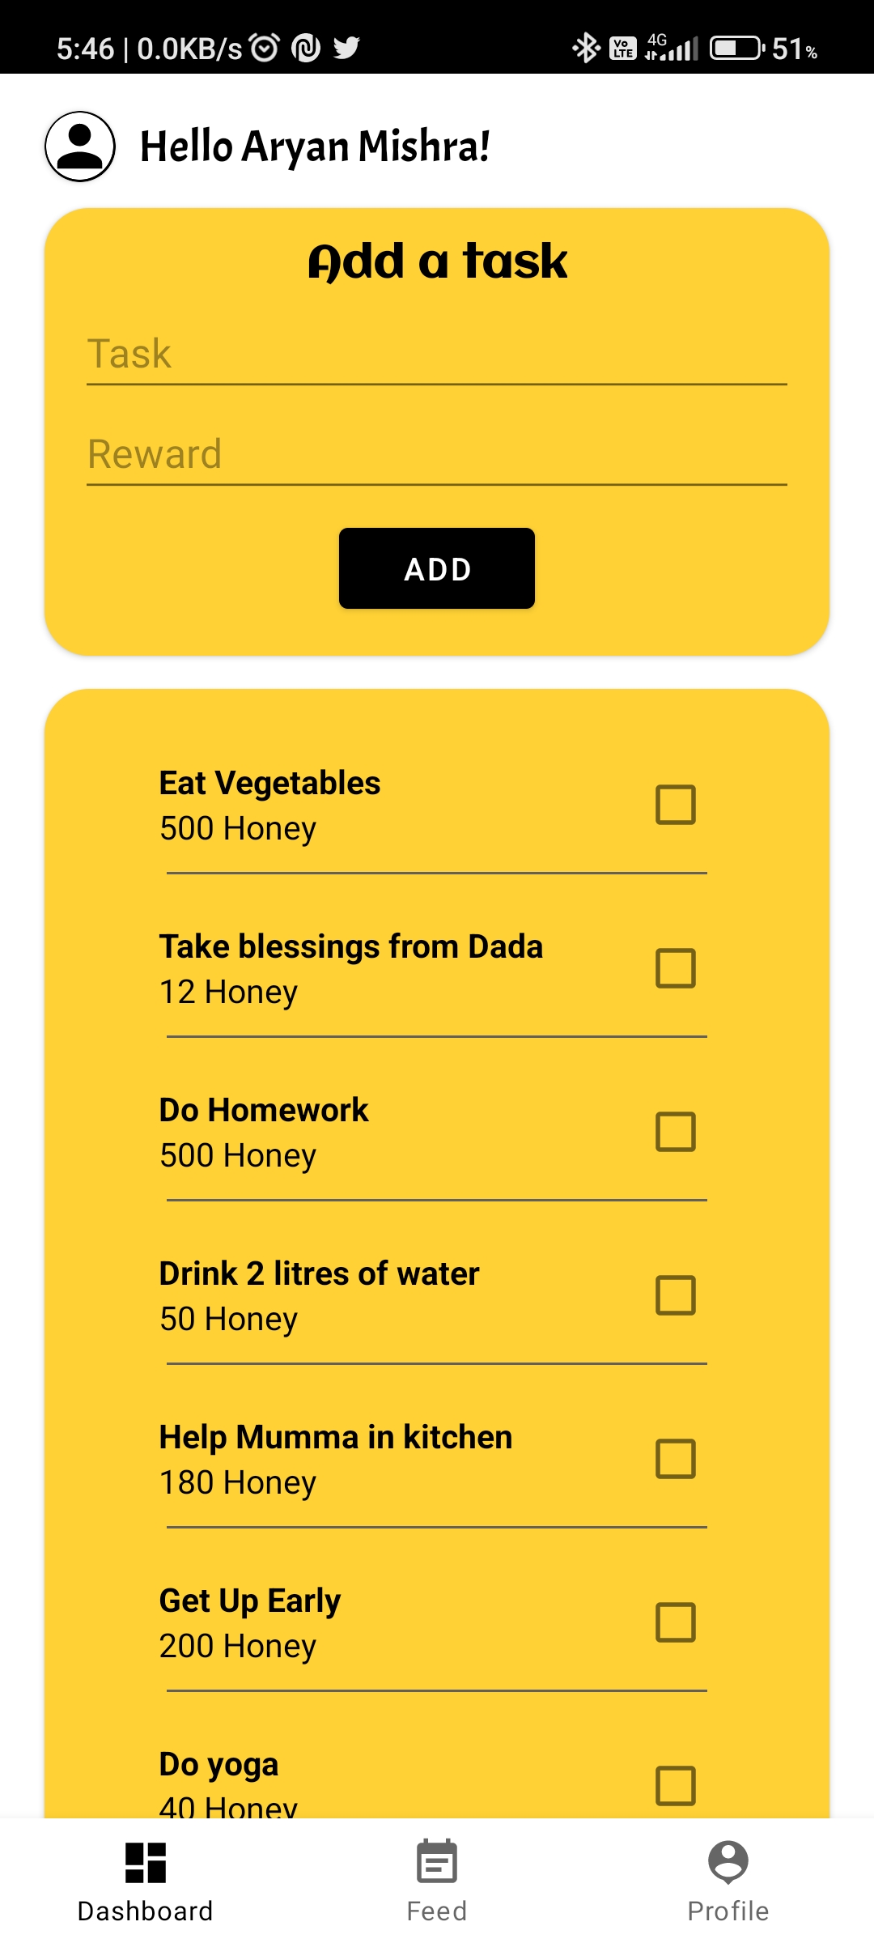
Add your task

Slide 12
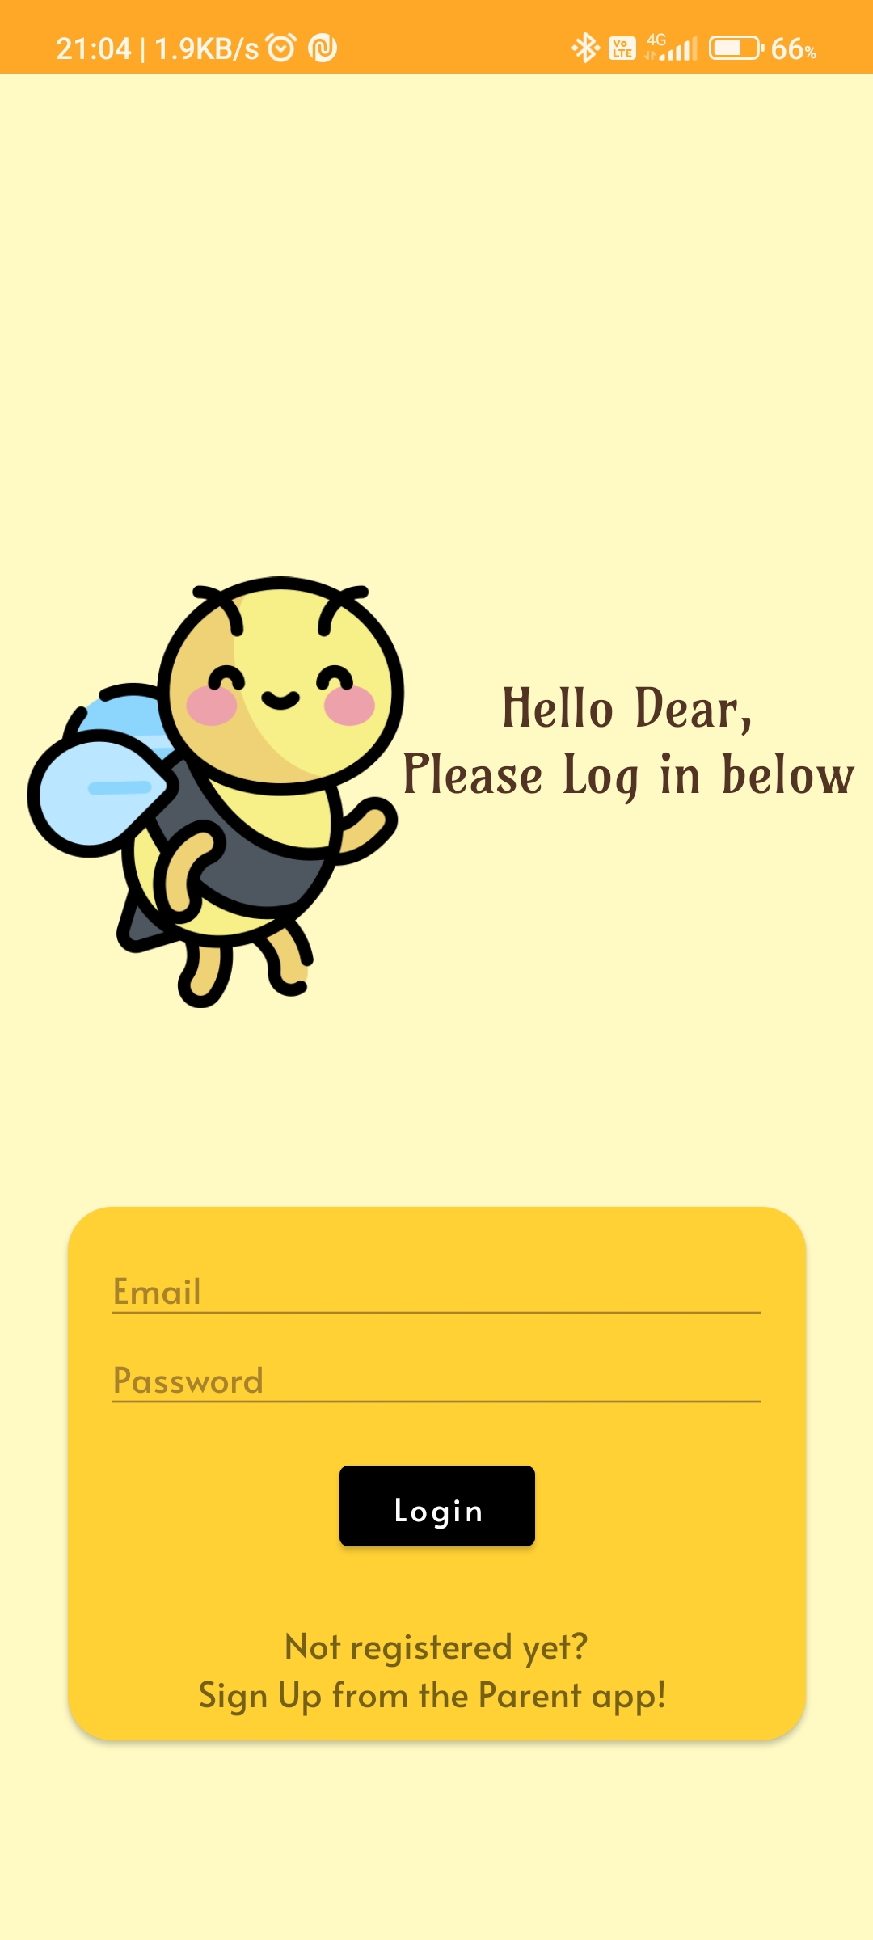
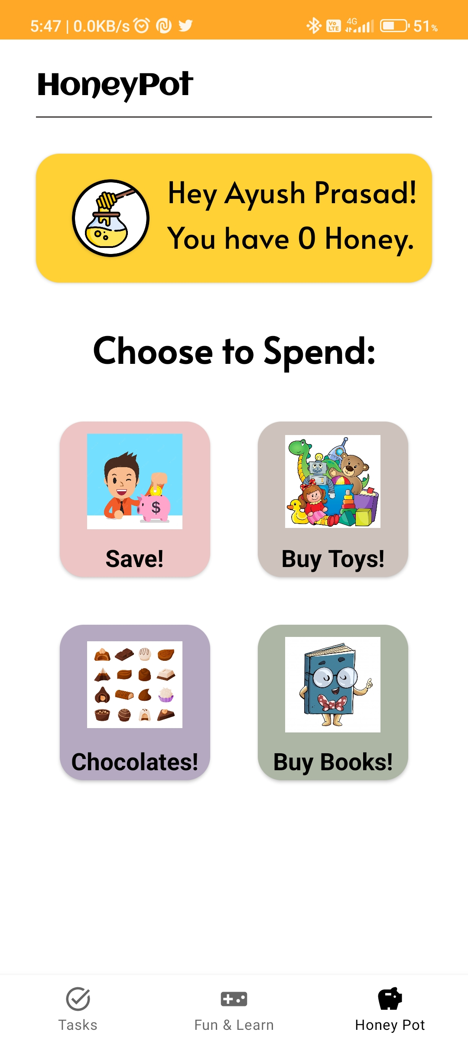
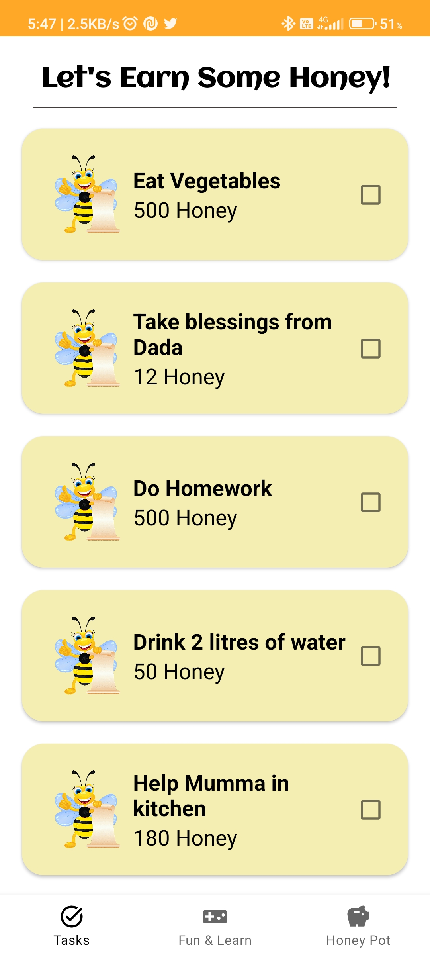
Child Side App
Sign in in the Child app through the Parent App
Dashboard with coin balance
Go to task tab to earn honey from tasks

Slide 14
How we get there​
ROI​
Niche markets
Supply chains​
Envision multimedia-based expertise and cross-media growth strategies​ Visualize quality intellectual capital​ Engage worldwide methodologies with web-enabled technologies​ ​
Pursue scalable customer service through sustainable strategies​ Engage top-line web services with cutting-edge deliverables​
Cultivate one-to-one customer service with robust ideas​ Maximize timely deliverables for real-time schemas

Slide 15

Summary
At Contoso, we believe in giving 110%. By using our next-generation data architecture, we help organizations virtually manage agile workflows. We thrive because of our market knowledge and great team behind our product. As our CEO says, “Efficiencies will come from proactively transforming how we do business.”

Slide 16

Thank you
Mirjam Nilsson
mirjam@contoso.com
www.contoso.com

